Slide 1




Cloud Native Applications
Workshop Kickoff

Slide 2


Miami – July 19th – 8:30 AM – 5:00 PM
Welcome!

Slide 3
Logistics
Breaks
Lunch
‘The Facilities’
Email & Cellphone Etiquette
Questions

Slide 4
Speakers
GAIG Team
Vinod Dsouza
Manager of Platform Architecture, Pivotal
Ravi Appalla
Platform Architect, Pivotal

Slide 5
Agenda
8:30 AM – 9:00 AM Breakfast and Registration
Enjoy breakfast with the team
9:00 AM – 9:30 AM Kickoff
Where we are and where we are going
9:30 AM – 10:15 AM Cloud Native Introduction
Industry Trends and Overview including: 12 Factor Apps, DevOps, Microservices and Cloud Platforms
10:15 AM – 10:30 AM Break
10:30 AM – 12:00 PM The Cloud Native Enterprise
Devops, Continuous Delivery & Microservices. What’s new, what isn’t, and what matters.
12:00 PM – 12:30 PM Lunch
Lunch will be provided
Notes:
At 11:30 get setup to do the install

Slide 6
Agenda
12:30 PM – 1:30 PM Cloud Native Platform
An overview of Cloud Foundry (PCF) and its Architecture
1:30 AM – 2:30 PM Spring Boot Primer
Getting started with Spring Boot. Let’s make an App!
2:30 PM – 2:45 PM Break
2:45 PM – 3:00 PM Services Made Easy
PCF Services (Database, Messaging, etc.) and the Marketplace
3:00 PM - 4:30 PM Developer Workshop
Hands-on pushing code with PCF
4:30 PM – 4:45 PM Wrap Up, Q/A, & Feedback

Slide 7
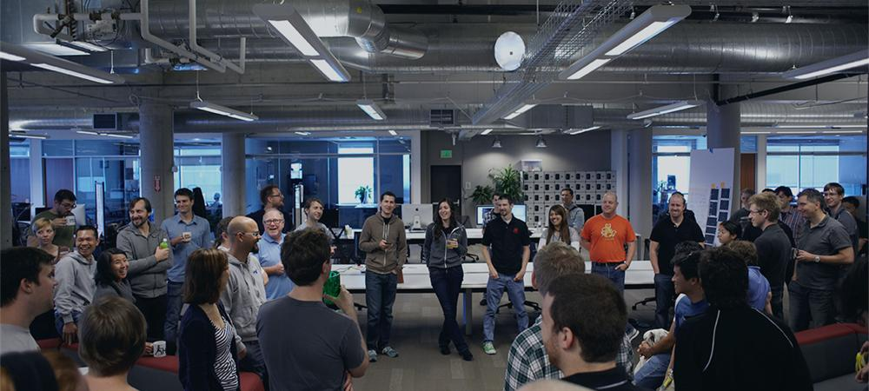
Introductions
Name, Team, Apps

Slide 8
Workshop Kickoff

